Slide 1
OPEN SOURCE PROGRAMMING PROJECT ONLINE NOTES MANAGEMENT SYSTEM
REVIEW -1
By:
Garvit 19BIT0023
Rohin Srivastava 19BIT0177

Slide 2
ABSTRACT
 | Online Notes Manager is a web based software that helps its users to create text based notes that might be handy for others too. So the portal will enable the user to upload notes online for other users. Therefore, it also has a download option for the users. The simplicity of the interface makes it easier to use and users can easily manage their notes or files online. Our efforts are to provide a web based application that helps users to create notes interactively. By using this platform, they can save their notes after creating and can also modify them whenever they want to.

Slide 3

PROBLEM STATEMENT
Notes making is one of the handiest technique one uses while learning new things. Notes summarizes the gist of the subjects and are always useful for revisions.
Whether the user is a student or a teacher, managing notes and circulating notes has been some of many the issues faced by many people.
So students and teacher need a platform where they can easily create and share their material.

Slide 4
REASONS FOR CHOOSING THIS TOPIC ?
Now-a-days students don’t require a notebook to write down notes which are being taught in the class, as students are being taught in smart class through presentations prepared by their respective faculties.
So, it is very difficult for the students to recall what they had studied in their classes and students had to bring storage devices to the classes to get the presentations or the notes.
Therefore, taking this into consideration, we tried to make a web application which will help both students and teachers. It will provide the best means to circulate notes, presentations and files. Hassle free downloading, uploading and creating notes will make learning easier!

Slide 5
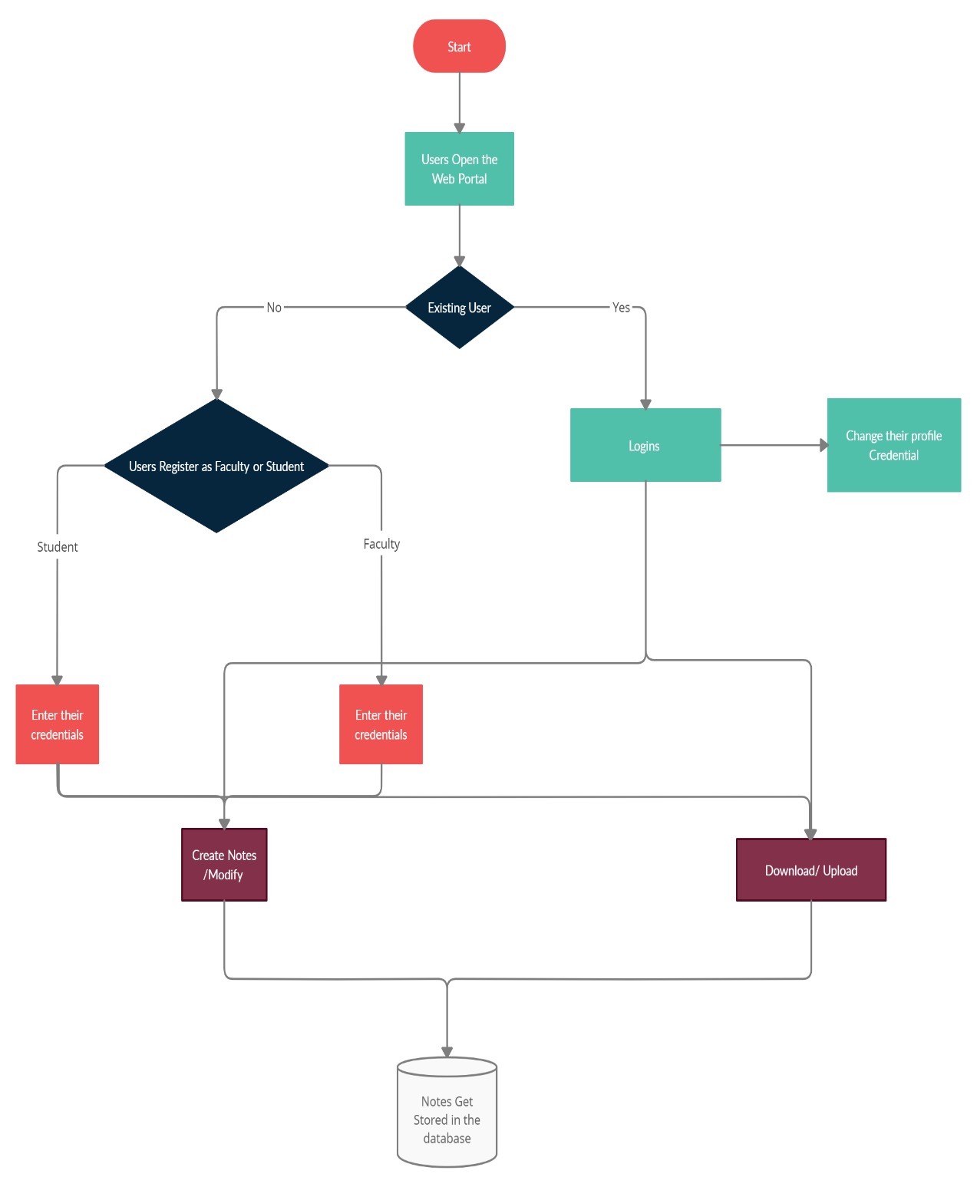
PROCESS FLOW DIAGRAM
PROCESS FLOW DIAGRAM

Slide 6
MODULES
MODULE 1: USER SIGN IN/ LOGIN:
In this module, if the user is opening the website for the first time has to sign in by giving his/her proper details, like username, name, password, gender, subject, and most imp type i.e., teacher or student. After sign in User can login into the site anytime he wants to just by giving his username and password. The details of the user get saved into the database.
MODULE 2: CREATE NOTES:
In this module, if the user wants to create notes on a particular topic then he or she can do it by using a text box provided in the website. They can save it using the save button. Later they can find it in the My Notes Section.

Slide 7
MODULE 3: UPLOADS/ DOWNLOADS:
In this module, if the user is a teacher then he/she can upload notes with a proper title and a short description about the note so that it will be easy for the student to find it. Teachers can upload note only in their subject section like a computer science teacher can uploads notes only in computer science section and same goes with the other domains. The file format can be a ‘pdf’, ’doc’, ’ppt’, ’txt’, ’zip’ and a max size of 30 MB. Teachers can also see other teacher’s profile and the notes uploaded by them. If the user is a student, then he/she can download their respective domain teacher’s notes, and can also view their profile.
MODULE 4: PROFILE EDITING:
In this module, a user can edit their profile details, like Username, Name, Phone number, E-mail id, also their Profile picture. It also has a feature of forgot password, if a user forgot the password then just the user has to type their registered E-mail id and a code will be sent to their e-mails and then the user is able to change their password.

Slide 8
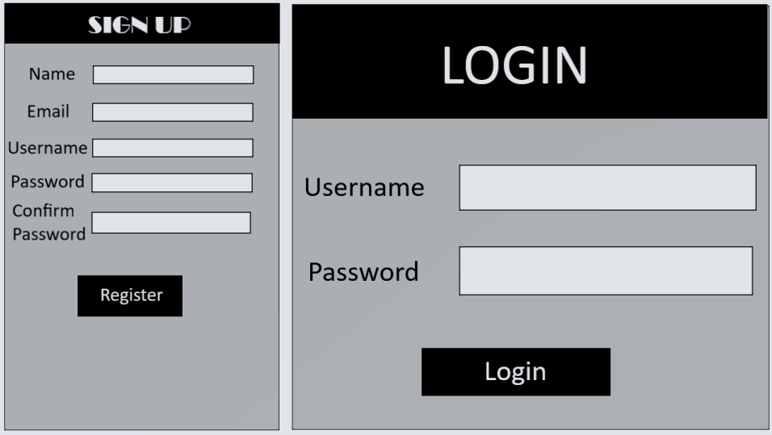
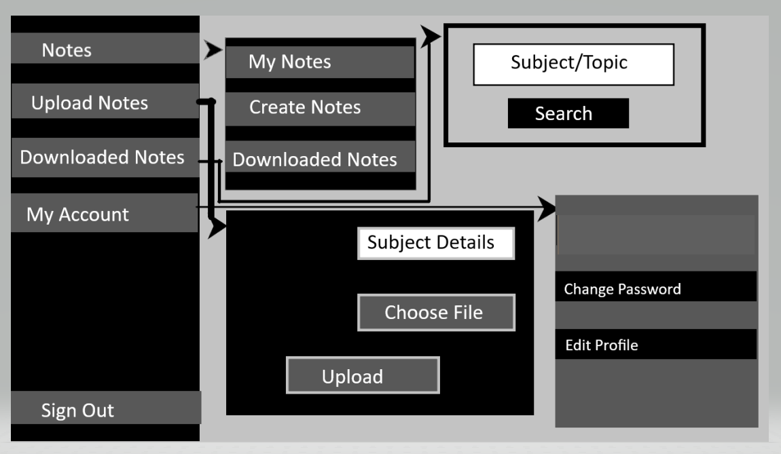
PROTOTYPE DESIGN

Slide 9
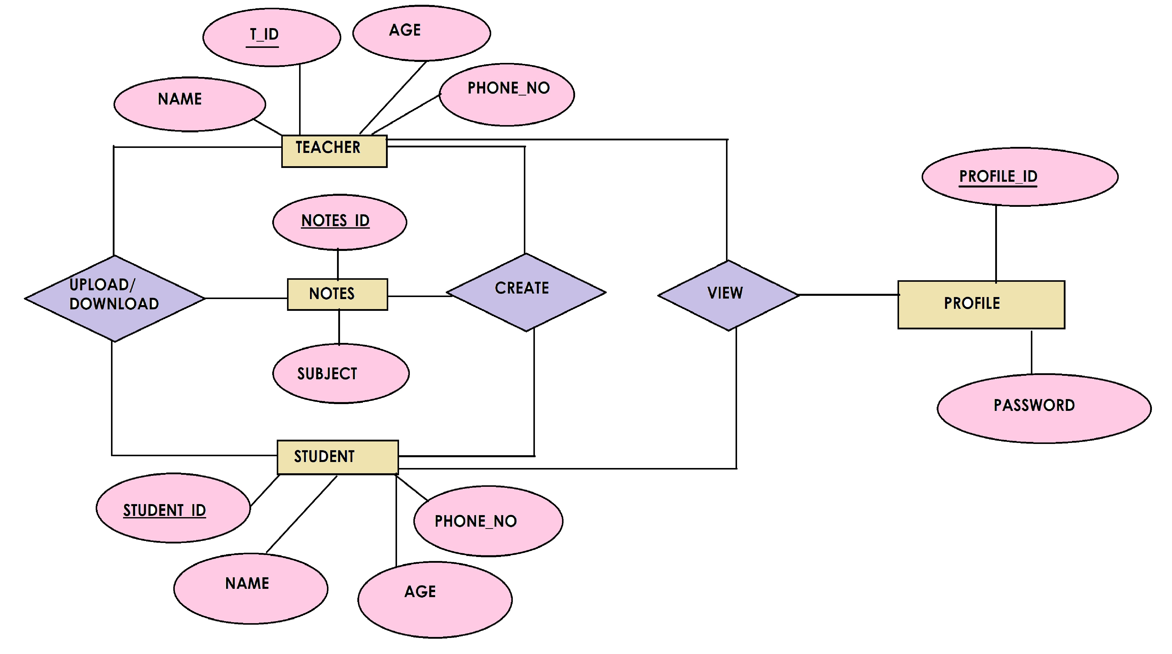
Entity Relationship Diagram

Slide 10
Database Design:
TABLES IN OUR DATABASE
Registration(username(pk),email,password,types,picture);
Notes (notes_id(pk),file_uploaded_on,file_uploaded_by,subject,types,path)
Saved Notes(file_name,file_uploaded_by,path)

Slide 11
References:
https://www.geeksforgeeks.org/
https://stackoverflow.com/
https://www.w3schools.com/

